Slide 1


THE VAGABONDS
Enthusiasts for exploring various opportunities and projects

Slide 2
The Team
Anushka Amte
Second Year Computer Engineering Student
Fr. Conceicao Rodrigues Institute of Technology, Navi Mumbai
Aaditee D. Pate
Second Year Computer Engineering Student
Fr. Conceicao Rodrigues Institute of Technology, Navi Mumbai

Slide 3

Pratyaksh - Data Visualization Competition
Aim to participate:
To apply the self learnt concepts of data science

Slide 4

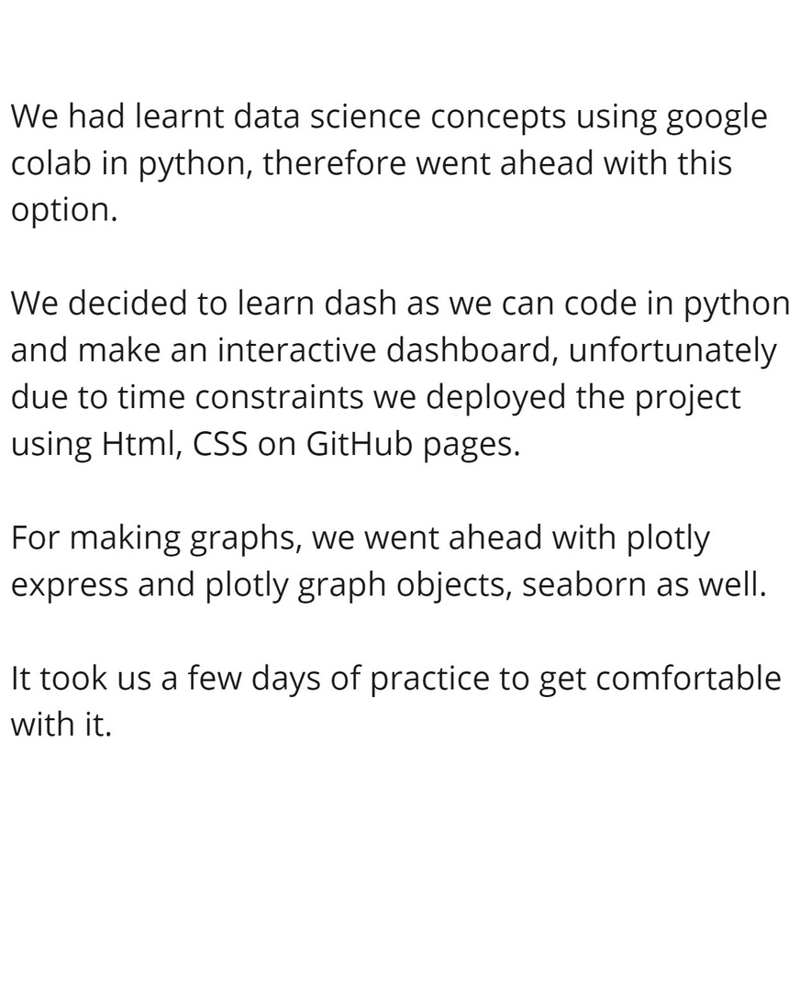
Our Approach

Slide 5

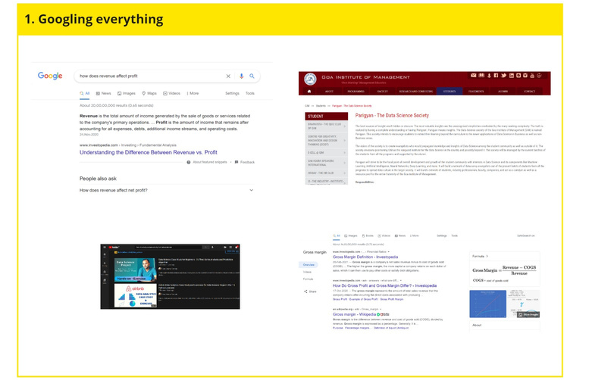
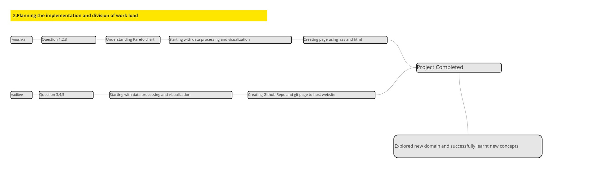

Slide 6

Our Analysis of the Questions

Slide 7
Site Traffic Analysis
DataFrame referenced: Site Traffic Data
Analyzed with Python and Visualized using Bar Graphs
The site traffic analysis made for the three countries tells us about the number of visitors visiting with respect to different channels, the channels with low visitors are the areas that the company needs to focus on.
50
40
30
20
10
0
Item 1
Item 2
Item 3
Item 4
Item 5

Slide 8

Parote Chart
DataFrame referenced: Sales Data
Analyzed with Pivot Table and Visualized using Parote Chart
According to the Pareto principle, almost 80% of the total margin comes from 20% of the high value customers.
By using the co-relation between the Revenue earned and Margin provided a list of high value customers is found from each industry.
Assumed threshold values:
Margin: $1000(>= are High value)
Revenue:$4000(>= are High value)

Slide 9
Dropped Industries
DataFrame referenced: Sales Data
Analyzed with Pivot Table and Visualized using Bar Graphs
Industries dropped in the second quarter of 2020 as compared to its first quarter differentiated by their tiers is visualized.
By filtering the data by quarters and comparing the number of orders a list of companies dropped in the last quarter can be segregated by their industry as well as tiers.
50
40
30
20
10
0
Item 1
Item 2
Item 3
Item 4
Item 5

Slide 10
Frequency of customers
Dataframe reference: Sales Data
Analyzed with python and visualized with Pie Charts
Summation of number of times a company has ordered, irrespective of location, quarter and industry.
Observed that majority of the companies ordered once, the percentage of companies ordering frequently is 0.2%, therefore made another pie chart to visualize the mentioned.
Item 5
20%
Item 1
20%
Item 4
20%
Item 2
20%
Item 3
20%

Slide 11
Profitable Companies
Dataframe reference: Sales Data
Analyzed with python and visualized with Bar Graph
According to the terminologies we understood, the factors that affect the profits are: Revenue, Margin, Frequency of ordering, Number of Units ordered.
Dropping rest of the columns for individual comparison between companies and the given factors, visualization of top 50 companies.
50
40
30
20
10
0
Item 1
Item 2
Item 3
Item 4
Item 5

Slide 12




GitHub Page
https://aaditeedp.github.io/Dashboard/
https://aaditeedp.github.io/Dashboard/

Slide 13
We would like to thank Parigyan GIM, judges and D2C for this opportunity

